Slide 1

Sentiment Analysis of Covid-19 Tweets –
Visualization Dashboard
Sparkling Newbies:-
Balaji Padamwar
Kishan Partani
Shriram Pareek

Slide 2
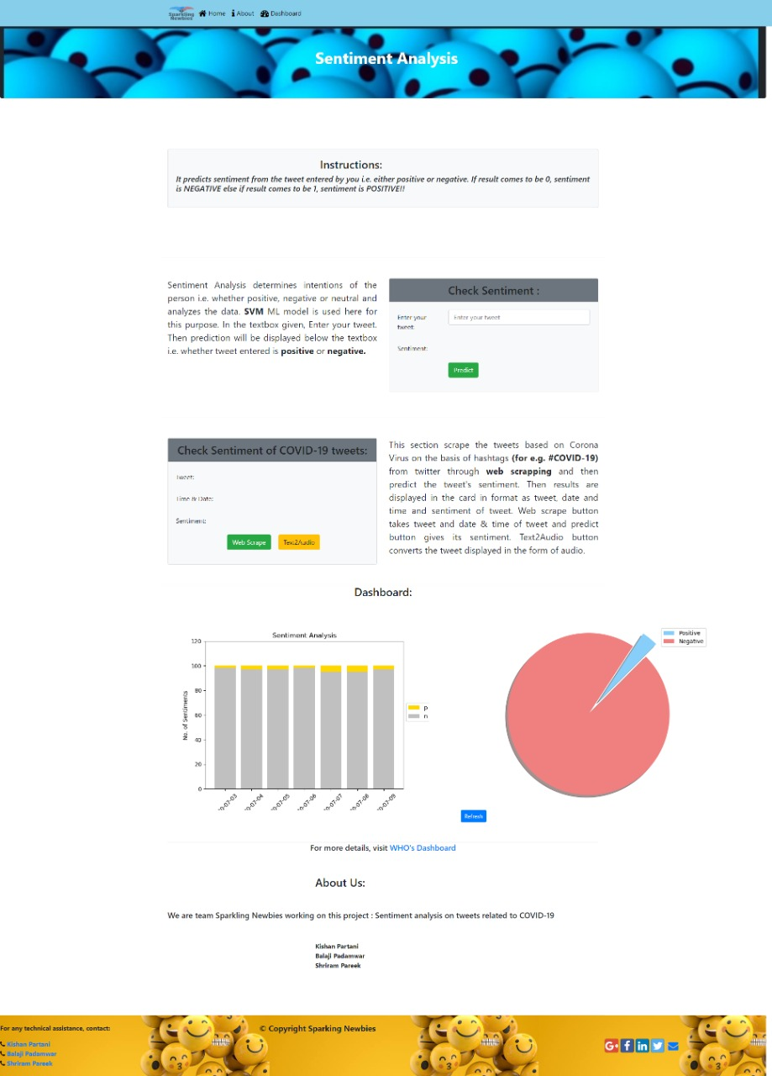
Introduction
In this period of Corona pandemic, the big focus is now on Corona and it’s related activities so to deal with it we made this web page with a ML model running in the background that deals with the sentiment of people.
Steps to be taken based on the people sentiment’s is a great task for the govt.
This model not only predicts the corona tweets but also user can enter the sentiment and statement they like to check it’s validation
The model has good accuracy of 96 %
There is also a visualization that shows result of past 7 days
Based on this results authority can take the proper and important steps

Slide 3
Block Diagram
Dataset Collection and pre-processing of the data
Dividing of dataset into test and train part
Vectorization of data
SVM model creation with proper accuracy
Dumping model & vectorizer into pickle file
Using this model and deploying it to Flask WEB app

Slide 4
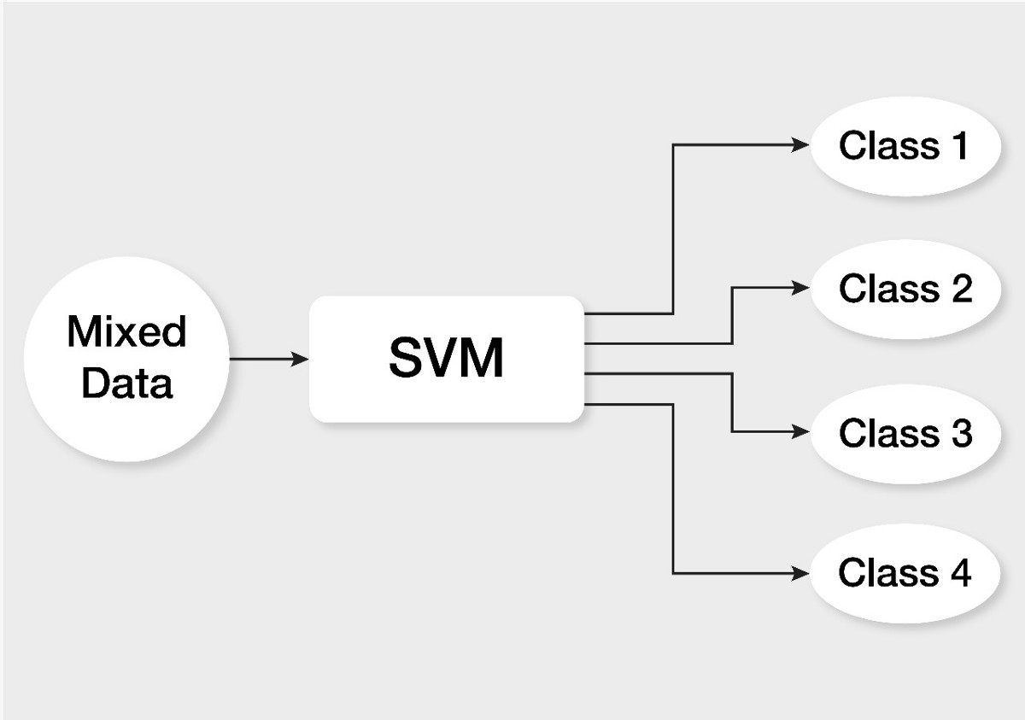
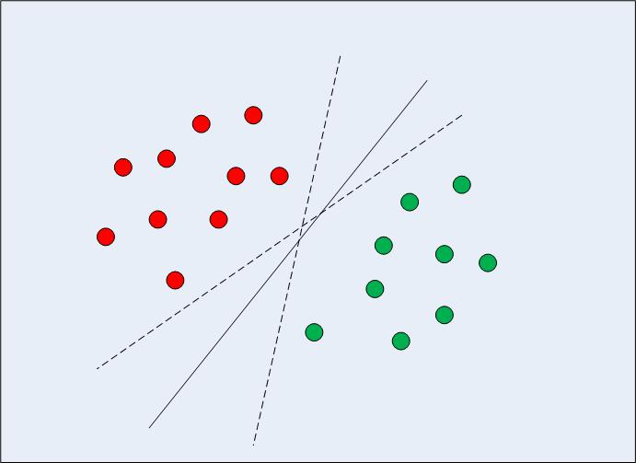
SVM Algorithm
In machine learning, support-vector machines (SVMs, also support-vector networks) are supervised learning models with associated learning algorithms that analyze data used for classification and regression analysis
An SVM training algorithm builds a model that assigns new examples to one category or the other
An SVM model is a representation of the examples as points in space, mapped so that the examples of the separate categories are divided by a clear gap that is as wide as possible
New examples are then mapped into that same space and predicted to belong to a category based on the side of the gap on which they fall

Slide 5
Flowchart
Data is collected from various sources
Data Pre-processing i.e removing the unwanted text
Then word tokenize is used to split the large text in words or sentences
Then comes the part of Lematization
Dataset is divided into train and test in ratio 7:3
Then this sentiments data is converted to vectors using Tfidf vectorizer
SVM algorithm is used for training and testing purpose
Then we have used accuracy score feature provided by sklearn library
This model is then dump in a pickle file
Then it is deployed using FLask web app.
This web app is loaded with features like text to speech and web scrapping
Finally user can not only predict his sentiment but also scrape the tweet of provided date

Slide 6
Applications
The predictive analysis provided by our model can help recognize the sentiments and views of the masses on important news like extension of lockdown or easiness and sectors now allowed to function and these sentiments then further help the manufacturers/service providers predict about the demand/supply chain as per the positivity/negativity provided by the people and hence work on the same
If the people are unhappy about any decisions taken by the authorities then they would react negatively of the same and our model will bring the same on to notice and then authorities could think about the matter once again
Prediction of unhappy business sectors of the country can be predicted and special schemes for them can be provided by the government
We can see the high frequency and negativity of the tweets and then can inform the authorities about the same and ensure peace and safety in the country

Slide 7
Special Features
Text to Speech
Tweet Scrapping
Google Text-to-Speech is a screen reader application developed by Google
It powers applications to read aloud (speak) the text on the screen with support for many languages
There may be some tweets that are scrapped on the web page are unable to pronounce by the user then this feature helps to understand that tweet
This also helps visually impaired people as they can get the results on just one click
Web scraping, web harvesting, or web data extraction is data scraping used for extracting data from websites.
Similarly tweets can be scrapped in 2 ways i.e. by using API and second is by using twitterscrapper library (here we have used twitterscrapper)
This helps in scraping the tweets of the date specified and the language provided by just mentioning the hashtags that we want(here we have used # as corona)
It helps user to get the live tweets they want

Slide 8
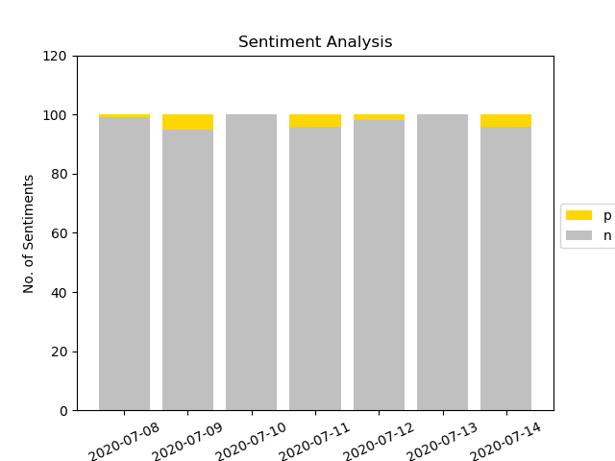
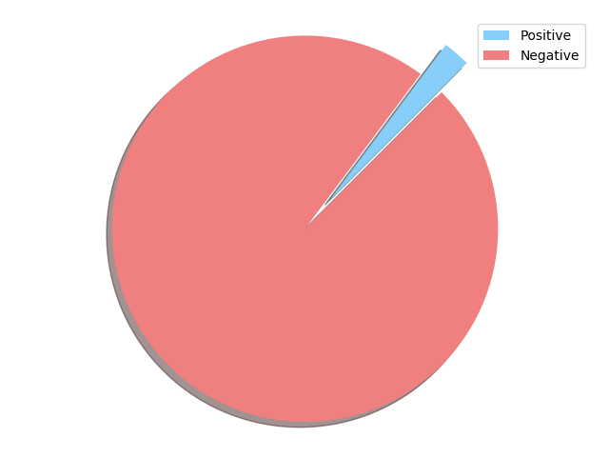
Visualizations

Slide 9
Advantages
The model provides with high accuracy sentiment analysis and also have undergone special training for covid19 tweets
The accuracy is around 96% which makes the model usable by everyone
Easy scraping feature is also added in case user wants to scrape live tweet
A special feature of text to speech is added which will help visually section too
A beautiful UI along with visualization graphs are also present which gives sentiment data for the past week

Slide 10
Disadvantages
The accuracy of model is around 96% which means user will not get correct result every time (but will get most of the time)
While scraping tweets, there can be network problems which will lead to slow down of the scraping process
Network issues can also cause problems in scraping and plotting of graphs and lead to slowdown of the site
User won’t get access to the visualizations that are more than a weak old

Slide 11
Future Scope
We can provide user with a choice to scrape and predict tweet from desired date
We can add geolocation feature which will scrape tweets and predict sentiments from a specified location and graph of same will be plotted
We can make an app of the same for mobile devices
Extensions for browsers can also be made which will predict and show sentiments next to tweets on twitter page

Slide 12


